Slide 1
Chernoff bound
Lee-Ad Gottlieb

Slide 2
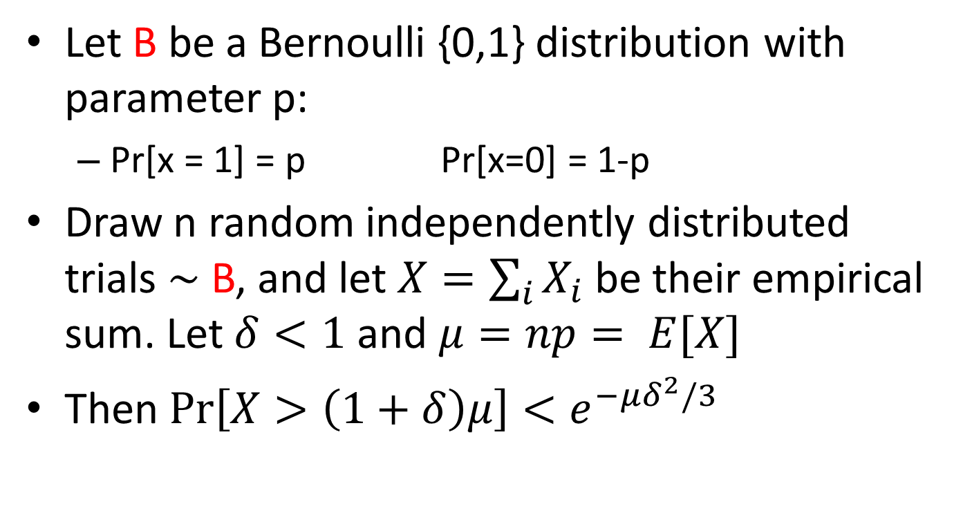
Chernoff bound
Let B be a Bernoulli {0,1} distribution with parameter p:
Pr[x = 1] = p Pr[x=0] = 1-p
Draw n random independently distributed trials $\sim$ B, and let $X=\sum_{i}{X_{i} }$be their empirical sum. Let $δ<1$ and $μ=np= E[X]$
Then $\operatorname{Pr}\left[X>\left(1+δ\right)μ\right]<e^{−μδ^{2}/3}$

Slide 3
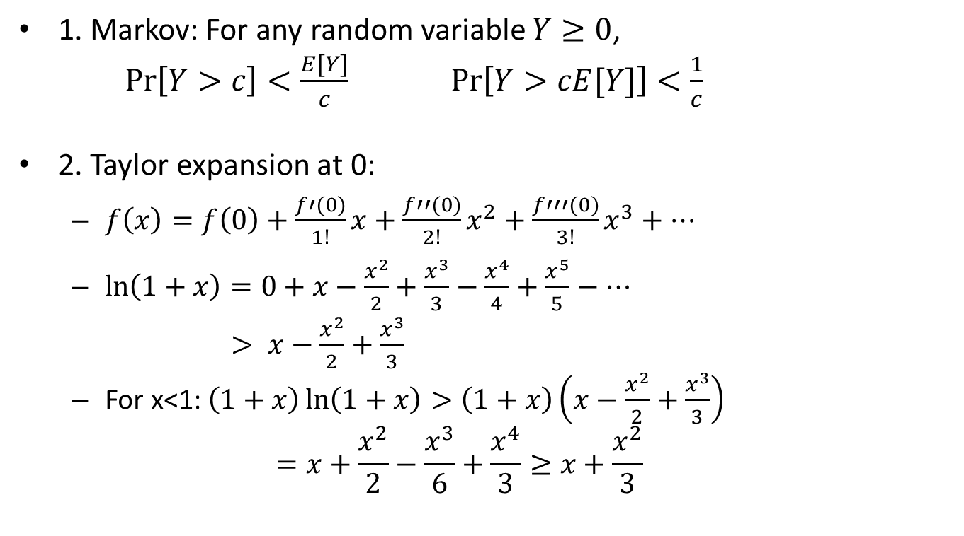
Preliminaries
1. Markov: For any random variable $Y≥0$,
$\operatorname{Pr}\left[Y>c\right]<\frac{E[Y]}{c}$ $\operatorname{Pr}\left[Y>cE[Y]\right]<\frac{1}{c}$
2. Taylor expansion at 0:
$f\left(x\right)=f\left(0\right)+\frac{f′(0)}{1!}x+\frac{f′′(0)}{2!}x^{2}+\frac{f′′′(0)}{3!}x^{3}+…$
$\ln\left(1+x\right)=0+x−\frac{x^{2}}{2}+\frac{x^{3}}{3}−\frac{x^{4}}{4}+\frac{x^{5}}{5}−…$
$> x−\frac{x^{2}}{2}+\frac{x^{3}}{3}$
For x<1: $\left(1+x\right)\ln\left(1+x\right)>\left(1+x\right)\left(x−\frac{x^{2}}{2}+\frac{x^{3}}{3}\right)$
$$=x+\frac{x^{2}}{2}−\frac{x^{3}}{6}+\frac{x^{4}}{3}≥x+\frac{x^{2}}{3}$$

Slide 4
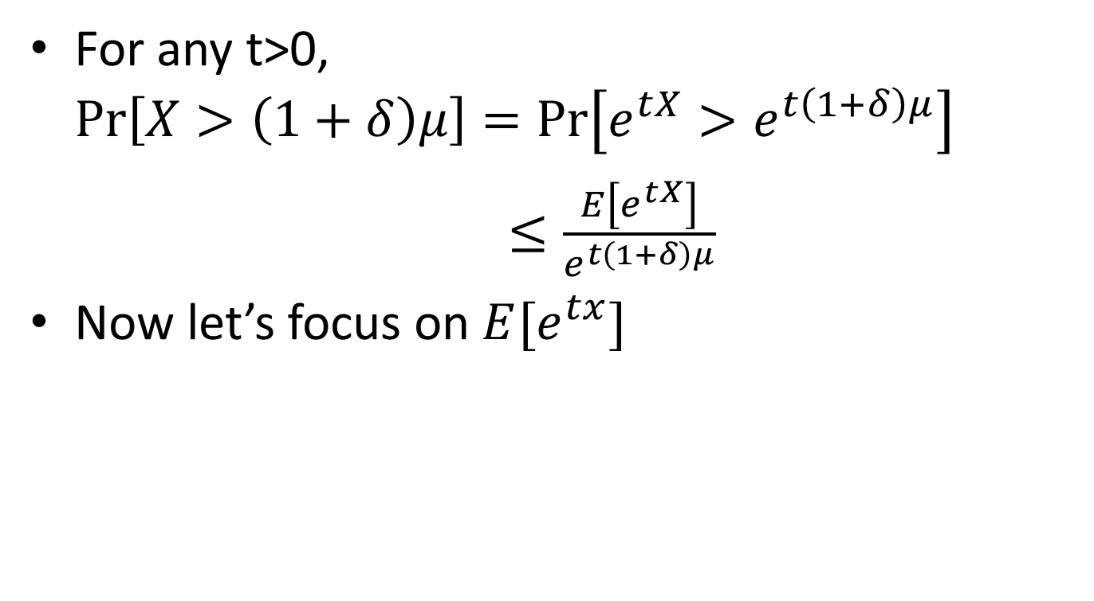
Proof
For any t>0, $\operatorname{Pr}\left[X>\left(1+δ\right)μ\right]=\operatorname{Pr}\left[e^{tX}>e^{t\left(1+δ\right)μ}\right]$
$≤\frac{E\left[e^{tX}\right]}{e^{t\left(1+δ\right)μ}}$
Now let’s focus on $E[e^{tx}]$
Markov

Slide 5
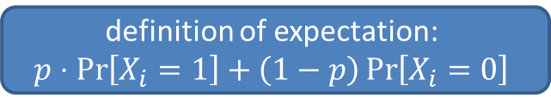

Proof
$E\left[e^{tX}\right]=E\left[e^{t\sum_{i}{X_{i}}}\right]$
$=E\left[Π_{i}e_{}^{tX_{i}}\right]$
$=Π_{i}E\left[e_{}^{tX_{i}}\right]$
$=Π_{i}\left(pe^{t}+\left(1−p\right)\right)$
$=Π_{i}\left(1+p\left(e^{t}−1\right)\right)$
$≤Π_{i}e^{{p(e}^{t}−1)}$
$=e^{n{p(e}^{t}−1)}$
$=e^{μ\left(e^{t}−1\right)}$
independence
definition of expectation:
$$p⋅\operatorname{Pr}\left[X_{i}=1\right]+\left(1−p\right)\operatorname{Pr}\left[X_{i}=0\right]$$
1+x ≤ e^{x}

Slide 6
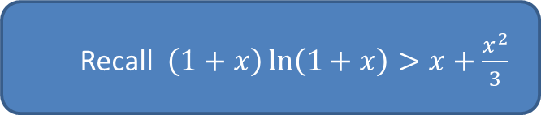
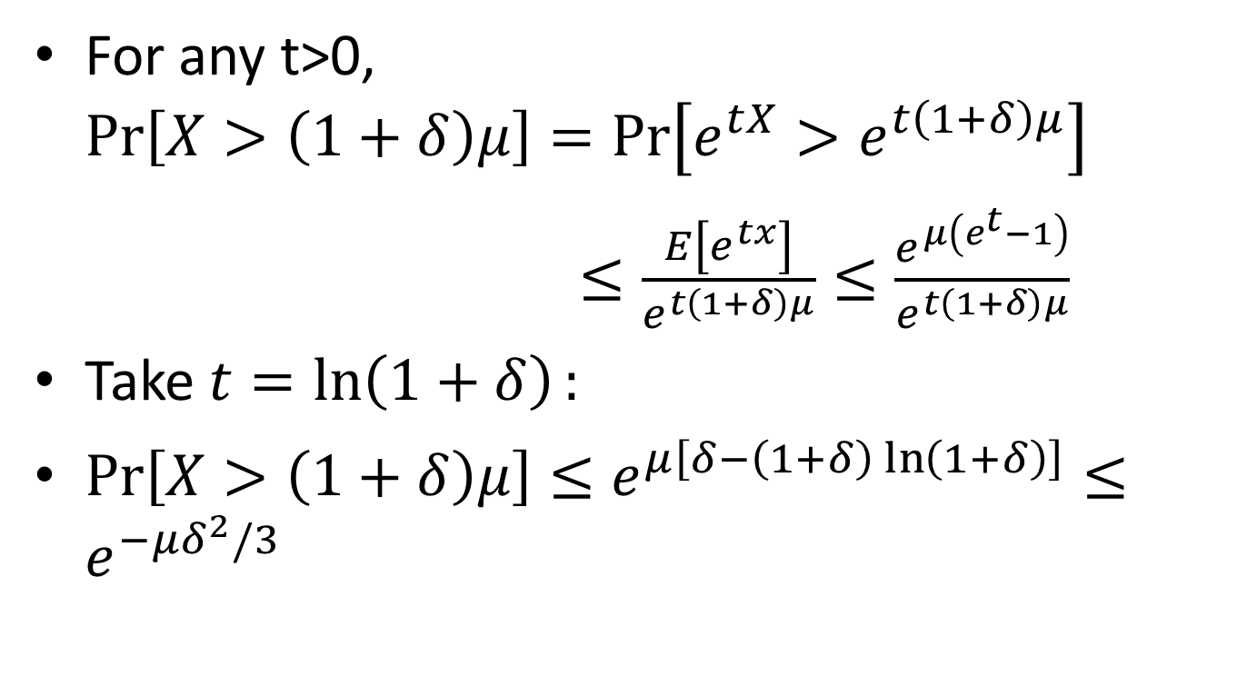
Proof
For any t>0, $\operatorname{Pr}\left[X>\left(1+δ\right)μ\right]=\operatorname{Pr}\left[e^{tX}>e^{t\left(1+δ\right)μ}\right]$
$≤\frac{E\left[e^{tx}\right]}{e^{t\left(1+δ\right)μ}}≤\frac{e^{μ\left(e^{t}−1\right)}}{e^{t\left(1+δ\right)μ}}$
Take $t=\ln\left(1+δ\right):$
$\operatorname{Pr}\left[X>\left(1+δ\right)μ\right]≤e^{μ\left[δ−\left(1+δ\right)\ln\left(1+δ\right)\right]}≤e^{−μδ^{2}/3}$
Recall $\left(1+x\right)\ln\left(1+x\right)>x+\frac{x^{2}}{3}$

